Slide 1

Green Gantry.
Sustainable roadside infrastructure for greener and cleaner traffic environment.
ASECAP Days November 2022 | Katharina Rynesch

Slide 2
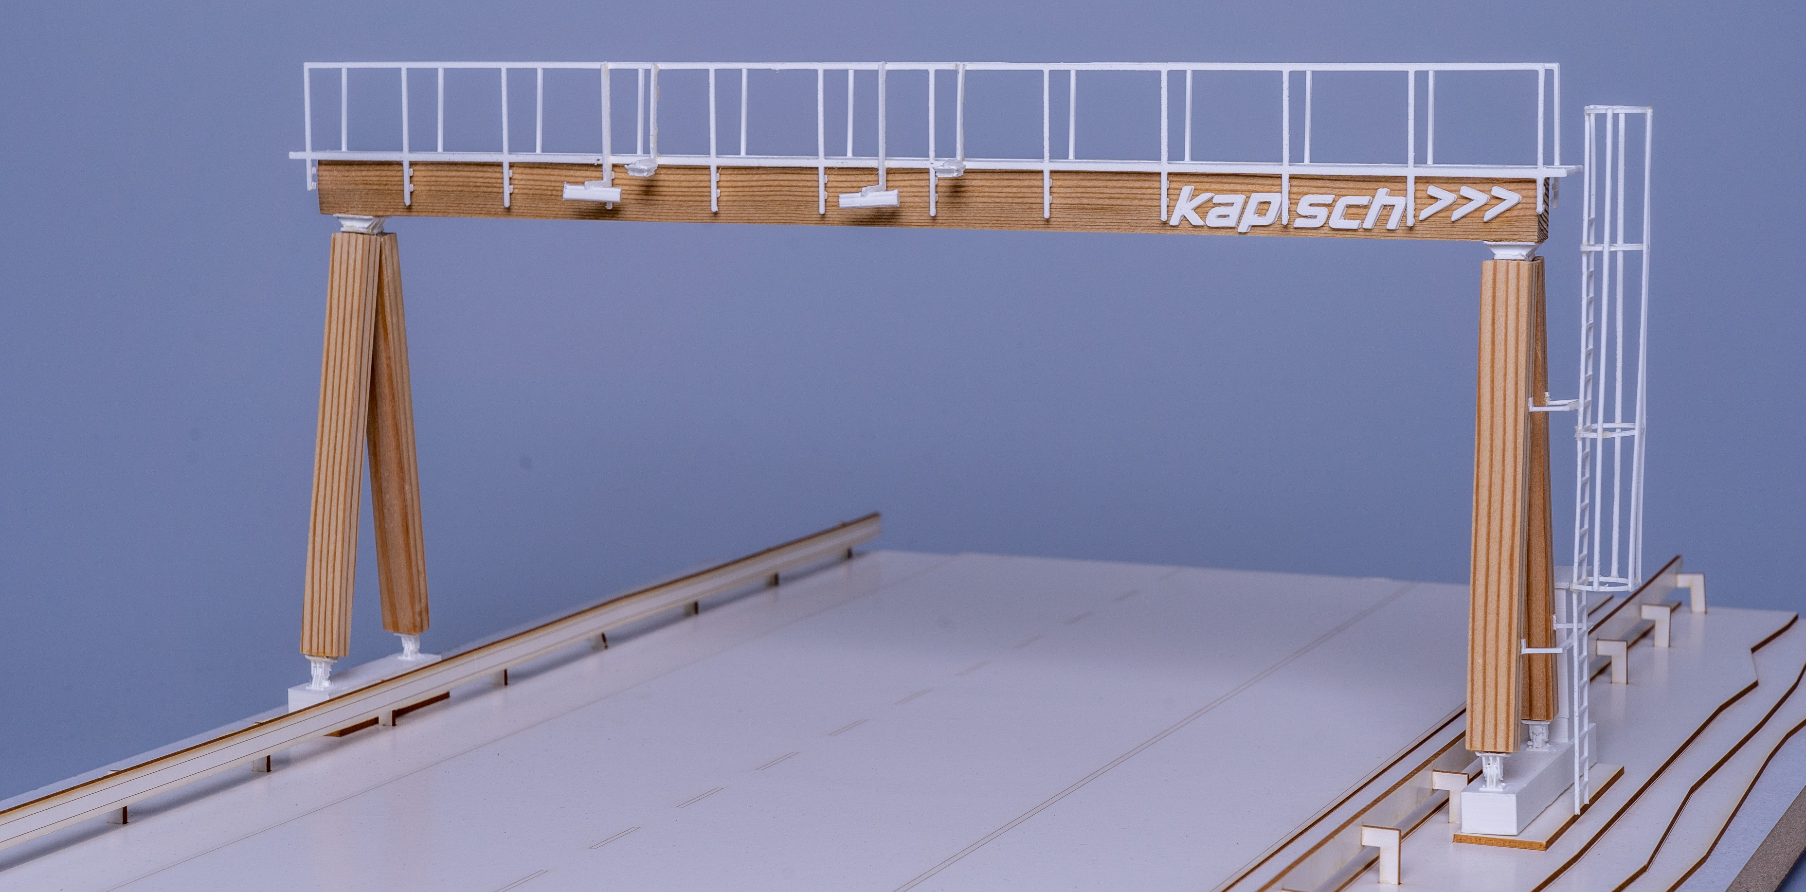

Green Gantry.
Our new sustainable wooden Roadside.
Made of wood.
Design fulfils the Eurocode standards for stability, durability & security.
Competitive in price, production, lifetime, resistance & maintenance
Reduces CO2 footprint of tolling solutions drastically. Saving up to 53t with one Gantry.
Innovative concept.
Modular design up to 35m
Available for different gantry sizes
Walkable and non-walkable
Laminated wood, constructive wood protection & planking
Foundation or installation on jersey barriers

Slide 3
Why to decide for wooden infrastructure.
Wood is a suitable material – also for roadside construction.
Local availability.
Green Gantry design for European region uses locally available types of wood. This ensures the best natural resilience against climate challenges (insects, etc.)
Circular economy.
No high-energy fossil fuels needed in the production. Wood can be grown & regrown and is biodegradable.
Resilient.
Laminated wood supplemented by non-chemical treatment & constructive wood protection against water, ice, snow. Guarantees a lifetime of 20+ years of a Green Gantry.
Reliable. Durable.
Wood burns with a known burning rate per hour, steel melts and collapses unpredictably. Yearly visual inspections & checks of connection parts (wood / steel) ensure reliability.

Slide 4


UnSustainable road charging solution. UnUsed chances.
Enable your contribution to a healthy environment.
Procurement.
Procurement requirements must allow or even require explicitly sustainable materials.
Tender.
Establish evaluation indicators to give preference to sustainable concepts.
Award.
Take your responsibility and select an environmentally friendly and green solution.

Slide 5
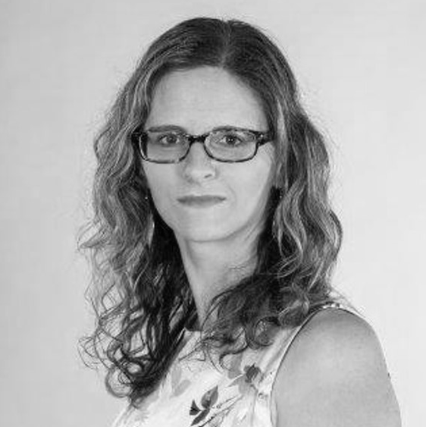
Katharina Rynesch
Innovation Manager
Technology Innovation | Corporate Technology
Kapsch TrafficCom AG Am Europlatz 2
1120 Vienna| Vienna | Austria
T +43 50 8 11 2411 | M +43 664 628 2411
katharina.rynesch@kapsch.net
www.kapsch.net

