Slide 2


C-ITS AND TOLL FREQUENCY THREATS
Manfred Haase
ASFINAG Maut Service GmbH
manfred.haase@asfinag.at

Slide 3
Agenda
The whole story of interference
What is interference?
What means interference for electronic tolling?
Who is interfering with electronic tolling?
Interference mitigation measures

Slide 4
What Is Interference?
Interference: Effect of unwanted energy upon reception
No exclusive usage of tolling frequency band
Interference cannot be completely avoided
Interferer avoids interference when “listening” before “talking”
Interference is unwanted energy perceived by the receiver:
Interferer
Receiver
Sender
Notes:
Interference is the effect of unwanted energy upon reception in a radio communication system.
There is no exclusive usage of the tolling frequency band
This means: interference cannot be completely avoided. The regulation assumes protection distances or requires mitigation techniques.
Incumbent applications are normally protected.
The regulation for road tolling systems is very old. However, „short range devices“ have even older rights.
New radio applications have to demonstrate that the incumbents don‘t get interfered. For that reason, CEPT performs compatibility studies.

Slide 5
What means interference for electronic tolling?

Slide 6
Toll Transaction – without interference
RSU to all: is there anybody?
RSU constantly asks for OBUs
…
Toll RSU
RSU to all: is there anybody?
Toll OBU
OBU to RSU: here is OBU #7
RSU to OBU#7: Your data please
OBU #7 to RSU: Here are the data
RSU to OBU#7: Confirmation
OBU #7 to RSU: Ok.
Communication Zone
RSU to OBU#7: End.

Slide 7
Toll Transaction – with short-term interference
RSU to all: is there anybody?
…
Toll RSU
RSU to all: is there anybody?
Toll OBU
OBU to RSU: here is OBU #7
RSU to OBU#7: Your data please
short-term interference
OBU #7 to RSU: Here is the Data
#!$%&/]! Interfering signal
RSU to OBU#7: Your data please
Repeated
Communication Zone
OBU #7 to RSU: Here are the data
Repeated
RSU to OBU#7: Confirmation
Repetition only possible until the vehicle leaves the communication zone!
OBU #7 to RSU: Ok.
RSU to OBU#7: End.

Slide 8
Toll Transaction – with long-term interference
RSU to all: is there anybody?
long-term interference
…
Toll RSU
#!$%&/]!
&&%$§(
&%$/()((
$$%³%%&
&&%%&&
Interfering signal
RSU to all: is there anybody?
Toll OBU
OBU: I can‘t understand anything
RSU to all: is there anybody?
RSU to all: is there anybody?
Communication zone
→ No toll transaction
→ Revenue lost!

Slide 9
Who is interfering with electronic tolling?

Slide 10
Possible interferers
Toll RSU
CEN DSRC
Generic Short Range Devices (SRDs)
C-ITS RSU
Fixed Wireless Access
Amateur Radio
W
Mil. Radars
C-ITS
OBU
C-ITS
OBU
W
Toll OBU
CEN DSRC
W
Wi-Fi in vehicles
Urban Rail ITS
(CBTC)
RLAN
(e.g. Wi-Fi)
Wi-Fi in vehicles
Smart Tachograph
W
W
WIA
Toll communication zone (approx. 10m)
Interference zone
depending on transmission power of the interferer and attenuation

Slide 11
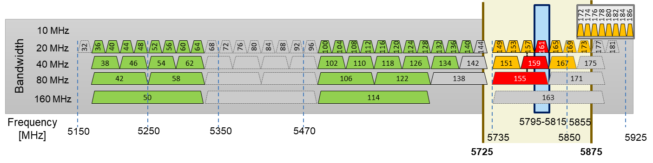
Usage of The 5-GHz frequency band
WiFi
(WLAN)
Short Range Devices
(SRDs)
Toll systems
C-ITS
WiFi channels and frequency
→ No problems
→ Potential problems
→ Problems expected

Slide 12
Use of The 5.8-GHz frequency band
There are more and more users around the tolling frequency at 5.8 GHz.
The tolling protocol can compensate short term interference, but not extensive interference.
Once interference becomes visible in toll transaction statistics, it is too late!
The interferers are already on the market and in the field.
Interference has a negative impact on revenue situation of toll chargers and toll service providers
Therefore: active cooperation in European frequency regulation and standardization, in order to prevent and avoid problems
Interference costs money!
Notes:
The frequency band around the tolling frequency at 5.8 GHz is becoming used more and more.
Potential negative impact on profit situation of toll chargers:
Compare revenue and success rate
Local short-term interference in individual toll stations might be partially corrected by the tolling protocol
Extensive interferences lead to a decrease of the success rate.
Interferences will only be discovered if the robustness mechanism in the toll system doesn‘t work anymore. But at this point it is too late as the interfering systems are already on the market and in the field.
Developments of the frequency regulation and standardisation in this area has to be followed.
Therefore: active cooperation in CEPT, ETSI and CEN, in order to prevent and avoid problems

Slide 13
Interference mitigation measures

Slide 14
Why do we need mitigation measures?
Older rights count
  incumbent radio applications are normally protected
  Short range devices (SRD) even older rights than tolling systems
New rights lead to (potential) problems
  More transmission power
  New frequency bands
  New technologies
  More frequent transmissions
  Not “listening” before “talking”
Notes:
The frequency band around the tolling frequency at 5.8 GHz is becoming used more and more.
Potential negative impact on profit situation of toll chargers:
Compare revenue and success rate
Local short-term interference in individual toll stations might be partially corrected by the tolling protocol
Extensive interferences lead to a decrease of the success rate.
Interferences will only be discovered if the robustness mechanism in the toll system doesn‘t work anymore. But at this point it is too late as the interfering systems are already on the market and in the field.
Developments of the frequency regulation and standardisation in this area has to be followed.
Therefore: active cooperation in CEPT, ETSI and CEN, in order to prevent and avoid problems

Slide 15




Who influences the use of frequency bands?
CEPT Reports,
ECC Decisions
Legal acts based on CEPT decisions
Decision makers: radio authority
Referencing of Harmonised Standards in Official Journal of the EU
(→ CE marking)
Frequency regulation
(compatibility studies and decisions)
Harmonised Standards
(conformity with the frequency regulation)
Implementation in national
regulations
→ ASCEAP observer in ECC
European Telecommunications Standards Institute
→ ETSI/CEN standardization
Decision makers: mainly industry
→ EU consultations

Slide 16

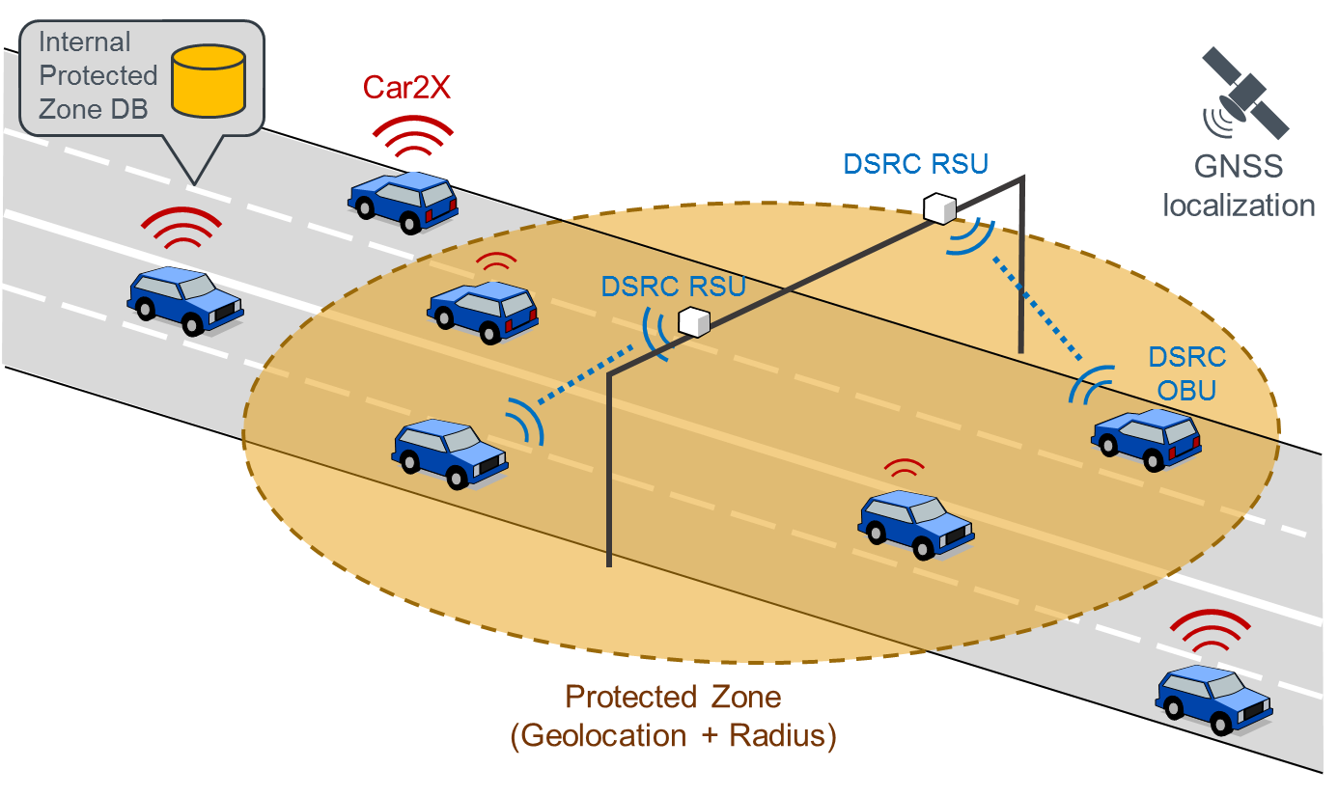
ASECAP Protected Zone Database
Database with protected zones will be installed by OEMs in vehicles
PZDB
C-ITS
Vehicles reduce transmission power and transmission frequency (Duty Cycle) in the protected zone while driving

Slide 17
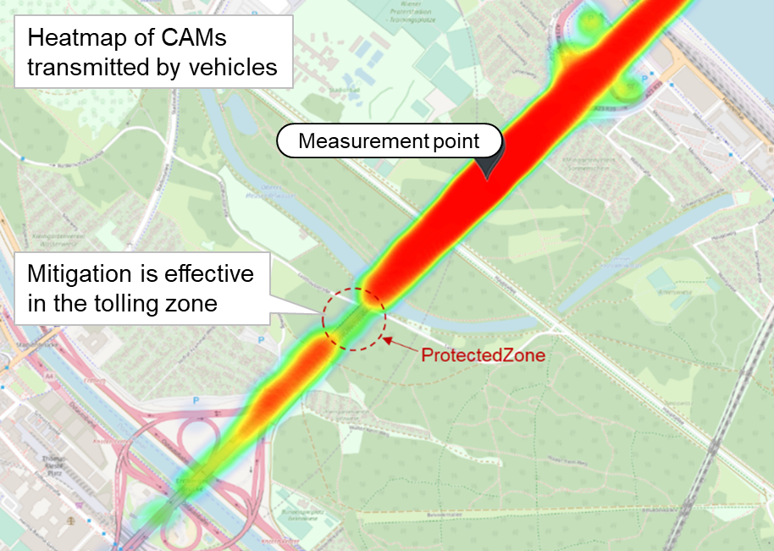
ASECAP Protected Zone Database
Database with protected zones around toll stations
C-ITS equipped vehicles use the PZDB and mitigate interference in protected zones
Other radio applications can use it as well
Continuous updates of the PZDB is important
  by ASECAP members,
  in the vehicles by the OEMs
Widespread use of the PZDB is important
PZDB
Successfully used in
vehicles today!
Notes:
Database with protected zones around toll stations
Interference mitigation in protected zone mitigation techniques are to be used
Mitigation in protected zones is mandatory for ITS equipment.
Other radio applications can use the ASECAP protected zone database as well (WiFi, Wireless Industrial Applications, etc.)
Essential advantage: protected zones are just a small part of the land area of a country – thus the impact on other radio applications is small
Frequency regulation (CEPT) and standardisation (ETSI) have been made aware of the database.

Slide 18
Takeaways
The tolling frequency is not exclusive
  Tolling frequency is mandated in EU legal acts
  Interferences must be expected
  „The stronger (transmission power), the more frequent
  and the closer (distance, frequency), the worse“
  Interference into toll systems costs money
Biggest threats
  5G-V2X and LTE-V2X (2x more frequent transmissions)
  Non-compliant equipment
  Non-compliant use of equipment (indoor/outdoor)
Mitigation
  Active participation in frequency regulation (CEPT), standardization (ETSI, CEN) and EU consultations
  ASECAP protected zone database must be used

Slide 19
INSERT CONTACT DETAILS

